Slide 1
The Commonwealth Games
An outdated institution?

Slide 2
A quick history of the Games

Slide 3
Group 1
Although the name Commonwealth Games was first used in 1978 in Edmonton, the event began in 1930 in Hamilton as the British Empire Games and has been held every four years (except 1942 and 1946). As the British Empire declined, the name evolved to reflect changing political ties, becoming the British Empire and Commonwealth Games in 1954, the British Commonwealth Games in 1970, and finally the Commonwealth Games in 1978.

Slide 4
Group 2
The Games trace their origins to the 1890s, when Australian-born clergyman John Astley Cooper proposed a “Pan-Britannic” sports festival to unite the British Empire in friendly competition, though his vision was racially exclusive and focused on white “Anglo-Saxon” dominions. Inspired by the success of the 1928 Amsterdam Olympics, Canadian journalist Bobby Robinson revived the idea, leading to the first British Empire Games in Hamilton in 1930. The event was relatively small, with about 400 athletes from 11 teams, including British Guiana and Bermuda as well as the dominions.

Slide 5
Group 3
Although rooted in the British Empire, the Games have expanded to include countries without direct imperial ties, such as Mozambique (since 1998) and Rwanda (since 2010), while some former participants, like the Irish Free State, stopped competing after independence in 1949. Australia holds the strongest overall medal record, followed by England and Canada. Hosting has largely been dominated by former dominions and home nations—especially Australia, Canada, New Zealand, Scotland, and England—with a few editions in countries such as India, Jamaica, Malaysia, and Wales, while Africa has yet to host the Games.

Slide 6
Group 4
Despite being called the “friendly games,” political tensions—especially over apartheid in South Africa—have affected the Commonwealth Games. The 1934 Games were moved from Johannesburg to London and Manchester due to concerns about racial discrimination. Later protests included Nigeria’s boycott of the 1978 Edmonton Games over New Zealand’s sporting links with South Africa, and a major boycott in 1986, when 32 nations refused to attend the Edinburgh Games in protest against the UK government’s stance on apartheid-era sporting relations.

Slide 7
Group 5
The 1930 Empire Games featured only six sports—aquatics, athletics, bowls, boxing, rowing, and wrestling—with women allowed to compete only in swimming and diving. Over time the programme expanded to include sports such as badminton, cycling, netball, rugby sevens, shooting, and weightlifting, with events now determined by the Commonwealth Games Federation and host cities. Women’s participation grew gradually at first but accelerated after 1978, with many new events added and major expansion in 1998. By 2006 only boxing and rugby sevens remained men-only, opening to women in 2014 and 2018, and today no sports exclude women, while netball and T20 cricket feature only women’s competitions.

Slide 8
Group 6
Unlike the Olympic Games, which are open to any nation with a National Olympic Committee, the Commonwealth Games are limited to members of the Commonwealth of Nations. As a result, they are much smaller—about 4,400 athletes from 71 teams in 2018, compared with over 11,000 athletes from 206 teams at the Tokyo 2021 Olympics—and far cheaper to stage. The Olympics also have far greater global commercial reach, reflected in the scale of their organization and infrastructure compared with the more modest Commonwealth Games Federation.

Slide 9
Group 7
The Games have been held in Great Britain seven times, including three in England, starting with the 1934 Empire Games shared by London and Manchester, followed by Cardiff (1958), Edinburgh (1970 and 1986), Manchester (2002), and Glasgow (2014). Several editions left lasting sporting infrastructure, such as Wembley Arena, built as the Empire Pool for 1934, and Manchester’s Etihad Stadium, originally the athletics venue for the 2002 Games before its conversion for football.

Slide 10
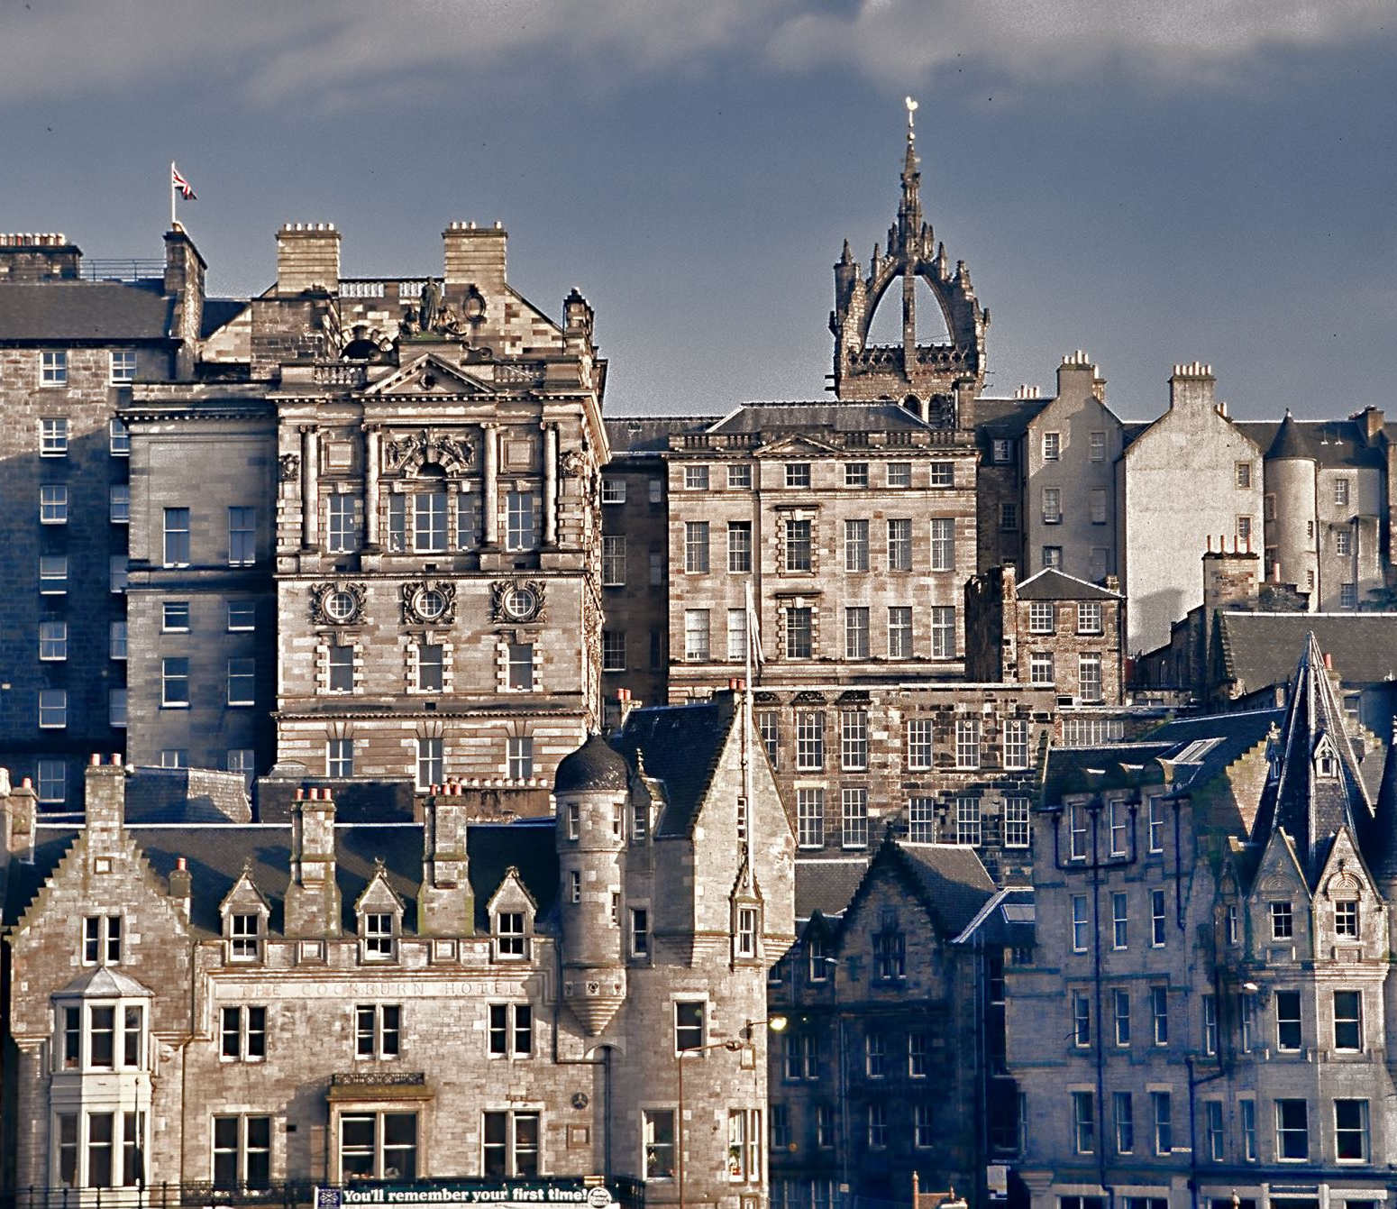
Glasgow 2026

Slide 11
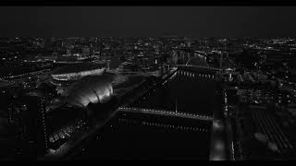
The journey to the 2026 Commonwealth Games begins

Slide 12
“A journey of painstaking preparation, of passion and endurance in the pursuit of glory.A journey of bubbling anticipation for the moments, the drama and the experiences that lie in wait.”

Slide 13
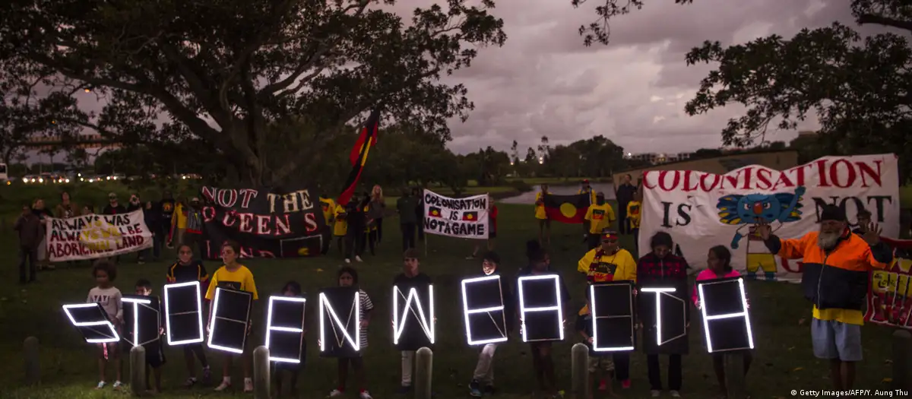

Slide 14
The King’s Baton Relay

Slide 15
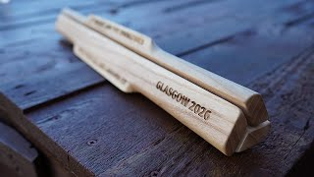

Slide 16


Slide 17
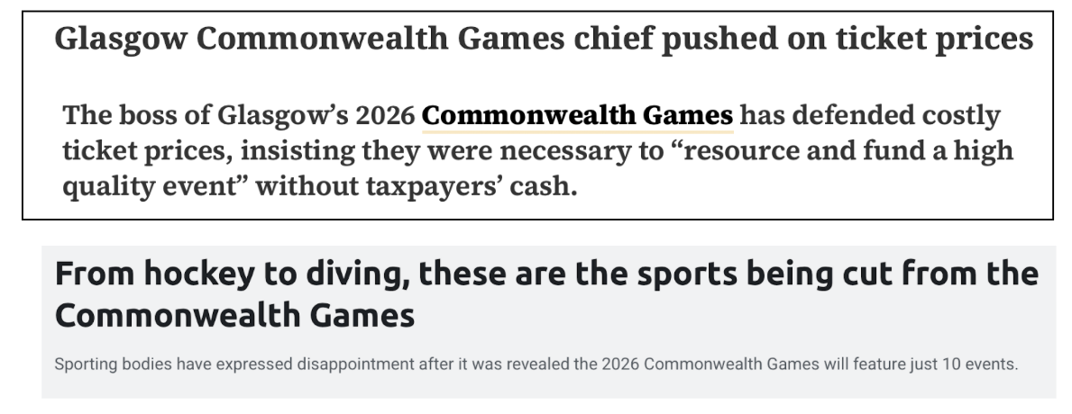
The costly games

Slide 18
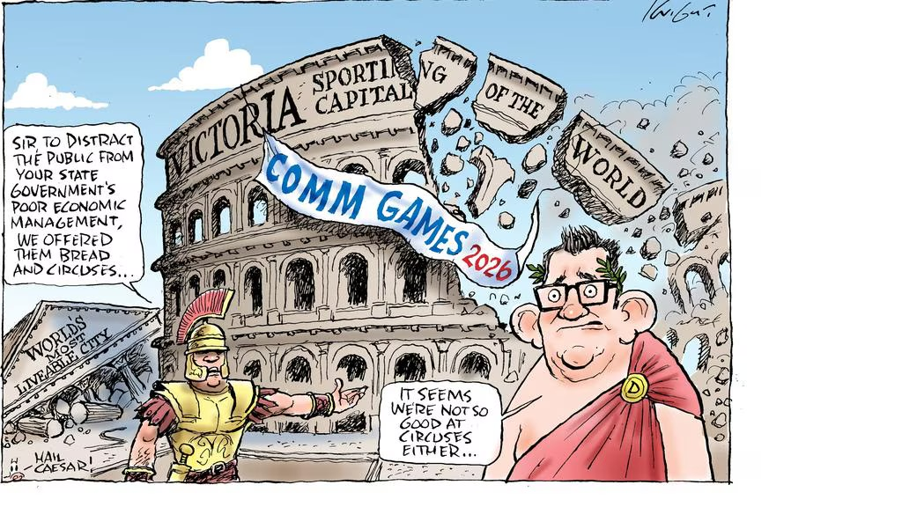

Slide 19
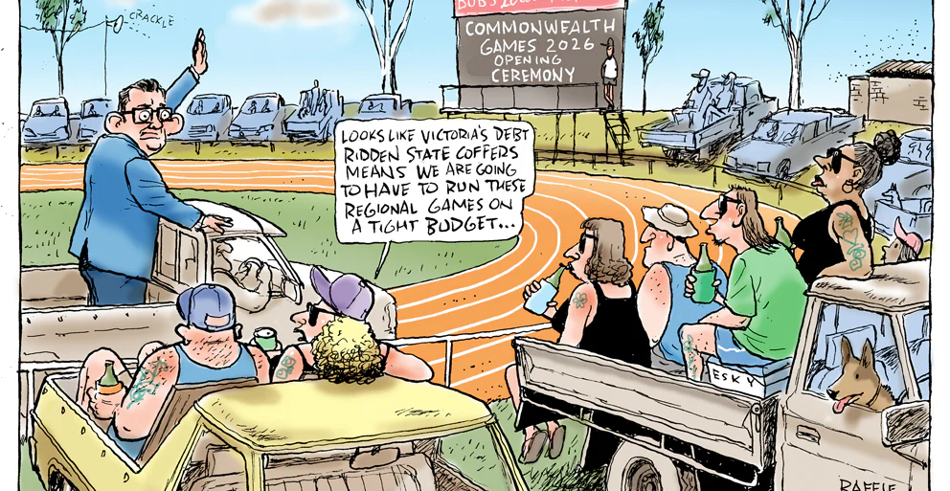

Slide 20
Different stakeholders :
1) Scottish Government / Glasgow organizers
2) Athletes from excluded sports (rugby, squash, volleyball)
3) Athletes from included sports (netball, athletics, swimming)
4) Commonwealth Games Federation
5) Local taxpayers / citizens of Glasgow
6) Sports fans / media commentators
In groups :
1) Identify your interests
2) Highlight benefits and losses

