Slide 1
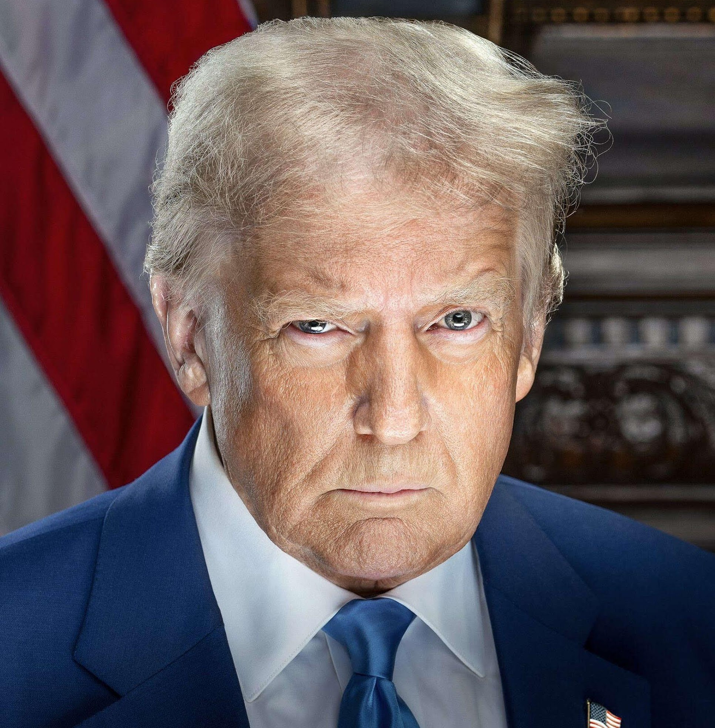
What is at stake with the early days of Trump’s second term?

Slide 2
Identify and analyze
Context
Major legislative milestone mentioned
Main areas of action highlighted
Notable visual elements and audio elements / construction of the video
Key expressions used to characterize the US / Trump. Analyze.

Slide 3
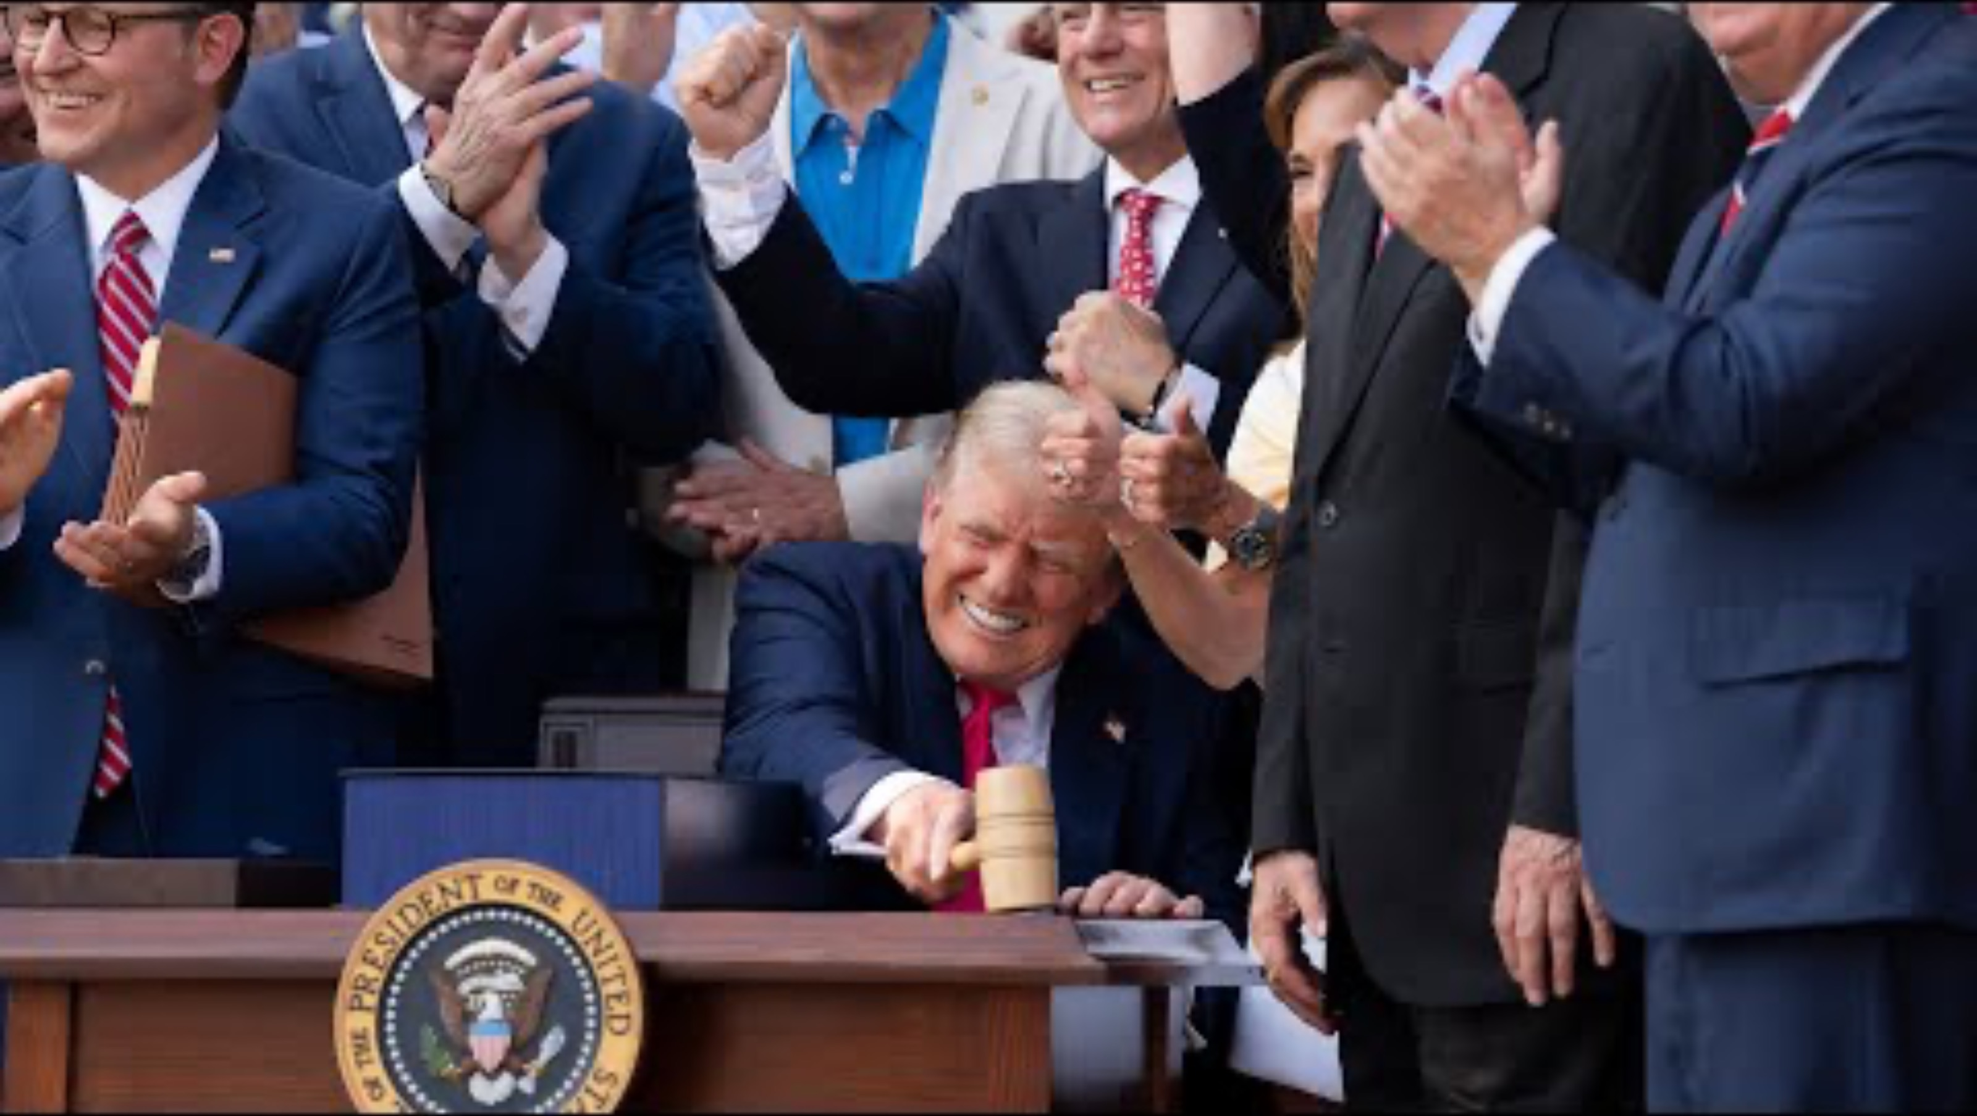

Slide 4
Correction
Context:
Released on July 20, 2025, this video marks the six-month anniversary of Trump’s second term. It’s part of an orchestrated media push to showcase his “America‑First” achievements and set the tone for a dominant second half. Strategically timed, it positions Trump as decisively reversing what he portrays as an era of decline under President Biden.

Slide 5
Correction
Major legislative milestone mentioned:
The centerpiece is the passage of the “One Big Beautiful Bill”—a sweeping legislative package that permanently enacts his signature 2017 tax cuts and funds border enforcement initiatives. This bill is framed as the most significant legislative achievement of his tenure thus far.

Slide 6
Correction
Main areas of action highlighted:
The video emphasizes three core domains of victory:
* Border security: Described as “fortified,” with record-low illegal crossings
* The economy: Portrayed as “unleashed,” boasting job growth, low inflation, stable egg prices, and stock market highs
* American power abroad: The tone celebrates the U.S. roaring back on the global stage—citing diplomatic ceasefires, oil-and-gas capabilitites, NATO spending diplomacy, and military action against Iran

Slide 7
Correction
Notable visual elements and audio elements / construction of the video:
Visual montage: Rapid cuts between powerful imagery—border fences, factory floors, flags waving, Trump signing bills, and interaction with world leaders—reinforce action and achievement.
Music & voiceover: A triumphant, driving soundtrack underpins the voiceover describing each initiative. The narrator's tone is commanding and urgent.
Editing style: High-energy pacing, bold title cards, and emphatic close-ups on Trump. The structure builds toward crescendo moments when key milestones are announced, reinforcing a victorious arc.

Slide 8
Correction
Key expressions & tone:
- Characterizing the U.S: “Roaring back” and “totally revived” paint the country as reborn. Phrases like the “hottest” and “most respected country in the world” amplify national pride and global dominance.
- Characterizing Trump: Described as “unapologetic, America‑first leadership”—a fighter who took command and launched an “all‑out offensive to crush the left’s mess”. Terms like “Command,” “offensive,” “crush,” and “power” underline a militant, no-compromise style, reinforcing Trump’s combative persona.
> The video is highly presidential and combative, portraying Trump as a decisive leader who has restored American greatness at home and abroad. The language is triumphant and aggressive—crafted to energize his base, deflate opposition, and depict a clear contrast with the prior administration. The message is loud and focused: six months of success, and only more dominance ahead.

Slide 9
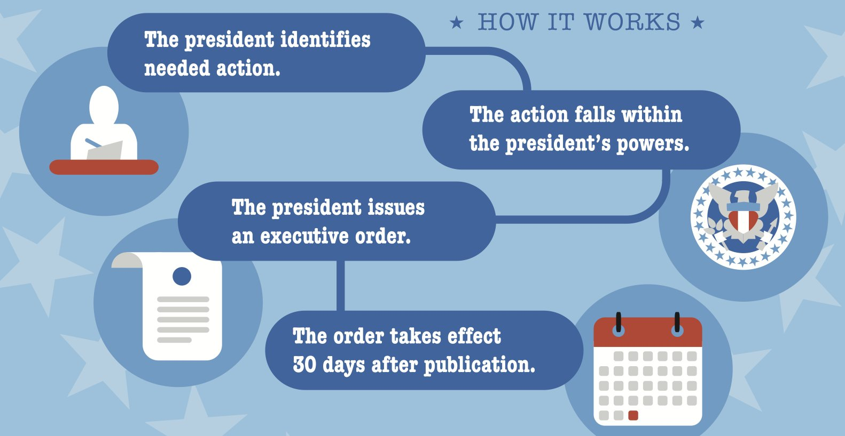

Slide 10
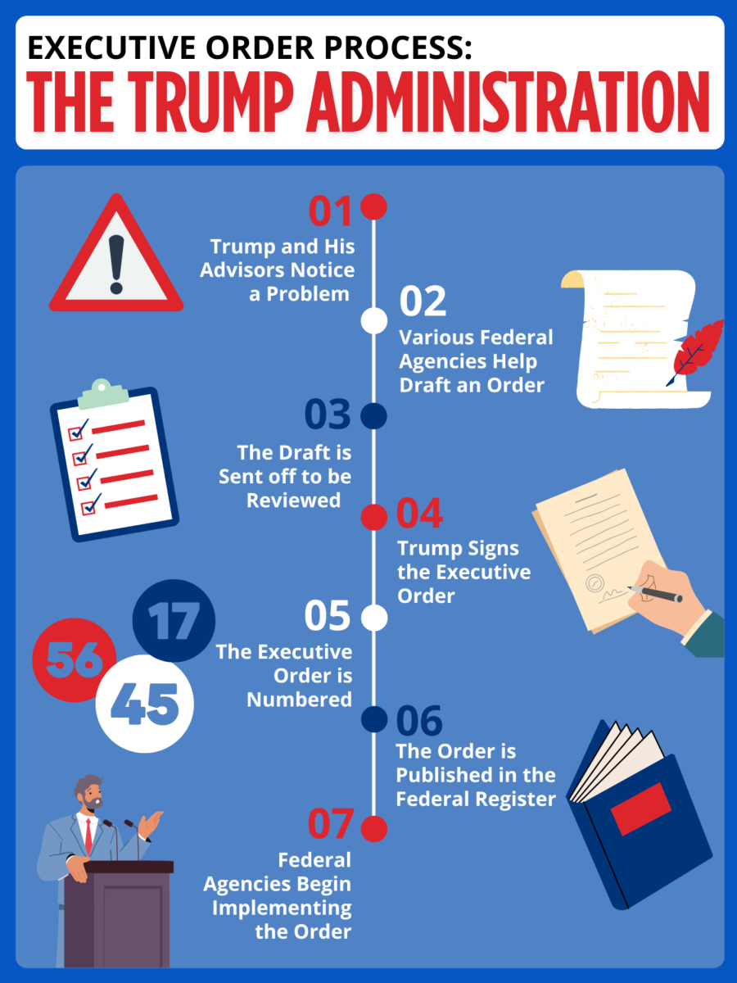

Slide 11
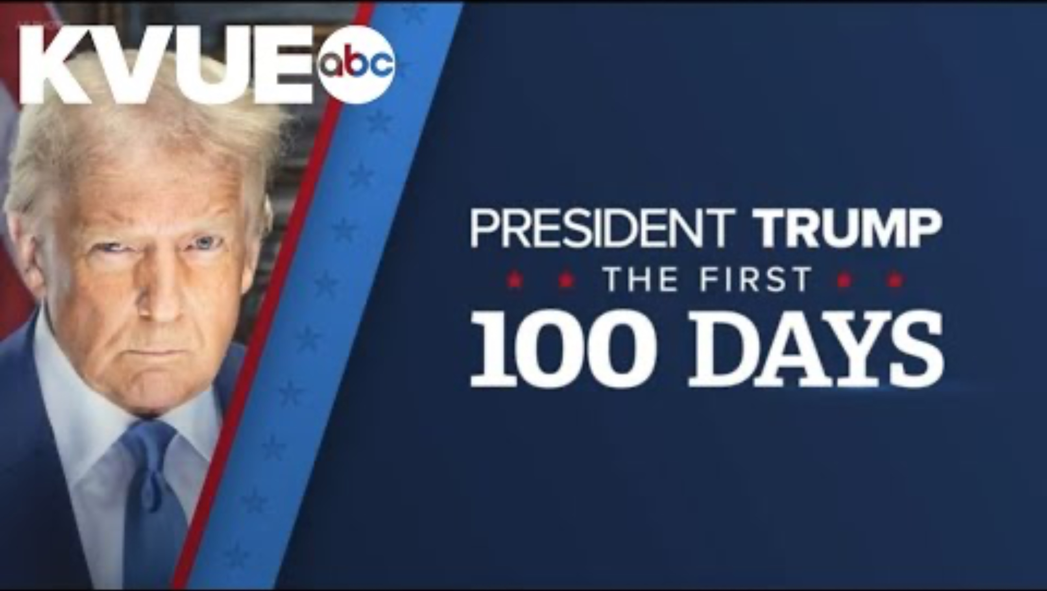

Slide 12
Executive orders:
They are issued by the President or a state Govenor, so heads of the Executive.
They apply to what is within the scope of Executive power, ie: White House staff, the military and federal agencies.
They are effective after 30 days.
Their scope is limited: they must respect the existing laws and cannot repeal or change them but they can interpret them and order how to enforce them.
If they misinterpret the law or if they exceed the powers of the Executive, they can by struck down.
BUT they are a true challenge to the Checks & Balances as they are increasingly used extensively, going beyond the need for immediate action or the limits of Presidential power, and circumventing Congress.

Slide 13
Look at the titles & react
1 | Preventing Woke AI in the Federal Government
2 | Making America Beautiful Again by Improving Our National Parks
3 | Unleashing American Drone Dominance
4 | Strengthening and Unleashing America's Law Enforcement to Pursue Criminals and Protect Innocent Citizens
5 | Reinstating Common-Sense School Discipline Policies

Slide 14
Look at the titles & react
1 | They are hyperbolic and emphatic, creating a sense of urgency and action
2 | They are populist and emotionally charged, framing issues in a way that resonates with everyday frustrations and cultural identity
3 | They are brand-like slogans
4 | It’s always Us vs Them
5 | They show a restoration narrative that is consistent with Make America Great Again

Slide 15
Correction of the Brochure – Examples of Executives Orders since Trump took office
Healthcare :
Withdrawing the U.S. from WHO
Protecting Children from Chemical and Surgical Mutilation : Describing gender-affirming care for minors as “mutilation,” this order cuts off federal funding (Medicare, Medicaid, ACA) for gender-affirming treatments for those under 19
The environment :
Unleashing American Energy : It weakens or removes the environmental review process for federal projects and accelerates approval of projects without full assessment of environmental impact.
Immigration :
Protecting the American People Against Invasion : Resets enforcement to maximum, directs nationwide task forces, expands detention capacity, threatens “sanctuary” jurisdictions’ funding, and prioritizes fines, visa bonds, and fast-track removals.
Protecting American Communities from Criminal Aliens : Targets “sanctuary” jurisdictions: directs DOJ to publish lists of non-cooperating cities/states and to restrict federal funds where lawful.
Human rights :
Ending Illegal Discrimination and Restoring Merit-Based Opportunity : Revoked the historic directive (dating to 1965) that required federal contractors to refrain from discrimination and engage in affirmative action—including protections for race, sex, sexual orientation, and gender identity.
Preserving and protecting the integrity of American Elections : It risks mass disenfranchisement (requires documentary proof of citizenship (passport, naturalization papers, or REAL ID with citizenship marker) to register for federal elections), and restricts absentee and mail-in voting (Ballots must arrive by Election Day to be counted (no longer just postmarked

Slide 16
Correction of the Brochure – Examples of Executives Orders since Trump took office
Free speech :
Restoring Freedom of Speech and Ending Federal Censorship : Bars federal agencies (including DHS, CDC, FBI) from communicating with social media platforms about content moderation.
Preventing Government Discrimination Against Religious Speech and Expression : Orders federal agencies to treat religious speech as equal to secular speech in grants, schools, and workplaces. + Allows federal employees and contractors wider latitude to engage in religious speech while on duty.
The economy :
Regulating Imports with a Reciprocal Tariff to Rectify Trade Practices : Declares a national emergency in response to persistent trade deficits and alleged unfair practices by other countries.
Deregulating Financial Oversight to Promote American Business Growth : Big banks no longer have to keep as much money on hand (capital) to cover potential losses. + Agencies like the Consumer Financial Protection Bureau (CFPB) and the Securities and Exchange Commission (SEC) have less power to monitor banks and corporations. + Loosens rules for risky investments

