Slide 1
SCOTUS & Civil Rights

Slide 2
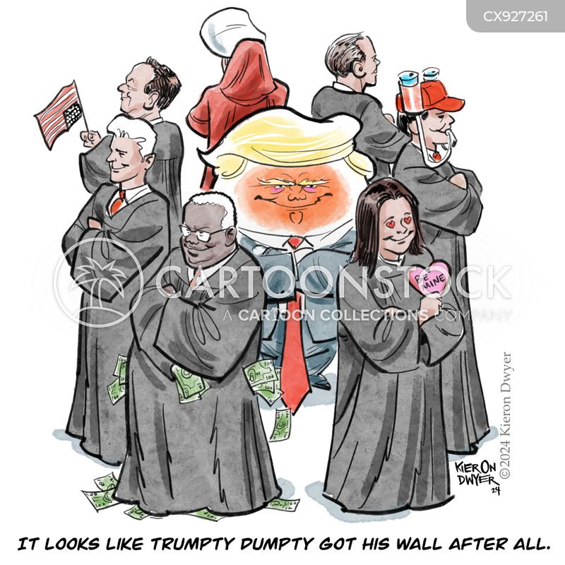

Slide 3
US Supreme Court bans race-based university admission

Slide 4
Main arguments against the end of race-based university admissions? | Main arguments for the end of race-based university admissions? | Direct consequences of SCOTUS’s decision

Slide 5
Sum up what you learnt about the end of race-conscious admissions by SCOTUS. What do you think about that ruling?

Slide 6
Supreme Court case to determine access to gender-affirming care for minors

Slide 7
1) Listen and define the following two concepts: > Gender dysphoria > Gender affirming care 2) Explain what happened in Tennessee? 3) What are the implications of the decision for families? Healthcare professionals? 4) What is the parallel between the current situation and reproductive rights?

Slide 8
Sum up what you learnt about the ban of gender affirming care. What do you think about that ruling?

Slide 9
Exclusive Inside the Supreme Court’s negotiations and compromise on Idaho’s abortion ban

Slide 10
Idaho | Iowa
What was Idaho’s abortion ban about? How did the Supreme Court take position regarding that decision? Are there any exceptions to the abortion ban in Idaho? If so, what are they? What are the implications for healthcare providers? women? neighboring states? | What recent legislative actions has Iowa taken regarding abortion? Why is it called the "fetal heartbeat law"? What exceptions, if any, are included in Iowa's abortion ban? What are the implications of Iowa's abortion laws for women who need emergency medical care? for neighboring states? for healthcare practitioners?

Slide 12
Supreme Court Delivers Shocking Verdict on Immigration!

Slide 13
1) What was the main issue in the case brought by the five Republican Attorneys General? A) They wanted to challenge the asylum ban introduced by the Biden Administration. B) They wanted to create new immigration laws in their states. C) They wanted the Supreme Court to enforce Title 42. D) They wanted to stop the settlement proceedings with immigrant groups.

Slide 14
2) What was the position of the Biden Administration on the asylum ban? A) They wanted to remove all restrictions on asylum. B) They believed the asylum ban was essential for border security after the end of Title 42. C) They planned to replace the asylum ban with a new law. D) They supported the Republican states in defending the rule.

Slide 15
3) Why did the Republican-led states want to intervene in the case? A) They believed the federal government was not doing enough to enforce immigration laws. B) They wanted to support the Biden Administration's asylum policies. C) They wanted to challenge the 9th Circuit decision. D) They were concerned about the economic impact of asylum seekers.

Slide 16
4) What was the outcome of the case when it reached the US Supreme Court? A) The Supreme Court agreed to hear the case. B) The Supreme Court upheld the 9th Circuit decision. C) The Supreme Court blocked the case and did not allow the states to intervene. D) The Supreme Court overruled the 9th Circuit’s decision and allowed state intervention.

Slide 17
5) What does the decision of the Supreme Court reflect about federal authority over immigration? A) The federal government has limited power over immigration. B) States have more power than the federal government on immigration matters. C) The decision reaffirms federal authority over immigration and border security. D) The federal government must consult with states before making immigration decisions.

Slide 18
6) What did the ACLU's response to the Supreme Court's decision indicate? A) They opposed the decision, believing it weakened federal power. B) They supported the decision, seeing it as a victory for state intervention. C) They welcomed the decision, supporting the denial of state intervention in federal immigration matters. D) They called for the case to be heard again in a lower court.

Slide 19
7) What was President Biden’s action in June 2024 related to the asylum issue? A) He introduced an executive order to increase border crossings. B) He proposed legislation to ease asylum restrictions. C) He introduced an executive order to cap border crossings at 1,500 per day. D) He reinstated the Title 42 restrictions for border security.

Slide 20
8) How have the Republican-led states generally been involved in immigration laws in recent years? A) They have passed numerous immigration laws that have been upheld in courts. B) They have made multiple attempts to introduce their own laws but have been blocked in lower courts. C) They have been fully supported by the federal government in their immigration policies. D) They have had little involvement in immigration-related matters.

Slide 21
9) What was the impact of the 9th Circuit’s ruling on the case brought by the Republican states? A) The ruling allowed the states to intervene in the case. B) The ruling prevented the states from having a significant interest in the asylum case. C) The ruling overturned the federal asylum ban. D) The ruling allowed federal control over all immigration-related matters.

Slide 22
10) What was the primary focus of the legal battle discussed in the text? A) Whether the US should open its borders to more asylum seekers. B) Whether the Biden Administration should be allowed to enforce its asylum ban. C) Whether states should have the right to create their own immigration laws. D) Whether Title 42 should be reinstated.

Slide 23
Sum up what you learnt about the Supreme Court’s latest decision regarding immigration. What do you think about that ruling?

Slide 24
Breaking SCOTUS Sides With Feds In Social Media Censorship Case — Huge Blow To Free Speech

Slide 25
TRUE or FALSE? The Supreme Court's decision in the case could change the way speech is handled on social media platforms.

Slide 26
True: The Supreme Court’s decision in this case could indeed have significant implications for how speech is handled on social media platforms. A ruling could affect the extent to which tech companies have the freedom to moderate and remove content, which in turn could change the way speech is managed and regulated online.

Slide 27
TRUE or FALSE? The case centers on whether social media companies have the right to remove content from their platforms according to their own editorial policies.

Slide 28
True: The case at the heart of these arguments is centered on whether social media companies have the right to determine which content stays on their platforms and which is removed. This is tied to their First Amendment rights, which would allow them to decide based on their editorial policies, similar to how traditional media outlets curate content.

Slide 29
TRUE or FALSE? Texas and Florida passed laws to limit social media platforms' content moderation after the removal of Donald Trump from Twitter and Facebook.

Slide 30
True: After the removal of Donald Trump from platforms like Twitter and Facebook following the January 6th attack on the U.S. Capitol, both Texas and Florida passed laws that restricted how these platforms could moderate content. These laws were designed to challenge what these states viewed as biased censorship, especially against conservative viewpoints.

Slide 31
TRUE or FALSE? The case only involves issues of censorship related to conservative groups.

Slide 32
False: While the issue of censorship, particularly against conservative groups, is discussed in the case, the matter is not exclusively about conservative censorship. It also involves broader concerns about free speech, content moderation practices, and how social media platforms exercise editorial control, which affects all users, not just specific political groups.

Slide 33
TRUE or FALSE? David Greene from the Electronic Frontier Foundation supports giving the government the power to impose editorial viewpoints on private tech companies.

Slide 34
False: David Greene, from the Electronic Frontier Foundation, opposes giving the government the power to impose its editorial viewpoints on private companies. He believes that social media platforms, like other entities such as art curators, have the First Amendment right to curate and manage content based on their own policies, without government interference.

Slide 35
TRUE or FALSE? The Supreme Court Justices struggled to categorize social media platforms either as newspapers or common carriers during the arguments.

Slide 36
True: During the Supreme Court arguments, the Justices grappled with whether social media platforms should be treated like newspapers, where they can decide what content appears and what is removed, or like common carriers (such as telegraph services), which simply carry messages without controlling or curating them. This categorization is essential because it affects how these platforms are regulated.

Slide 37
TRUE or FALSE? Justice Alito questioned whether content moderation could be considered censorship during the arguments.

Slide 38
True: Justice Alito asked whether content moderation could be another way of describing censorship, pointing to the complexity of the terminology surrounding the issue. This highlights the difficulty in defining terms like “content moderation” in the legal context and its potential overlap with censorship.

Slide 39
TRUE or FALSE? The Supreme Court Justices are aligned politically, with conservative justices supporting the laws and liberal justices opposing them.

Slide 40
False: Although the case is often framed in terms of conservative versus liberal viewpoints, the Supreme Court Justices did not seem to be focused on political ideology during the arguments. Instead, they concentrated on understanding the technical aspects of how social media platforms operate and how the laws could potentially affect them, regardless of political affiliations.

Slide 41
TRUE or FALSE? The outcome of this case will affect whether platforms can exercise editorial discretion or will have to allow all types of speech, including harmful speech.

Slide 42
True: The outcome of the case has the potential to drastically change how platforms exercise editorial discretion. If the platforms lose the case, they may be required to host all types of content, including harmful or hateful speech, without the ability to filter or moderate it according to their own policies. This would challenge the platforms’ ability to maintain a safe and respectful environment for users.

Slide 43
TRUE or FALSE? The Supreme Court is likely to resolve the issue by sending it back to a lower court for further analysis.

Slide 44
True: Given the complexity of the case and the lack of clarity about how broadly the laws could affect social media platforms and other online services, the Supreme Court may decide to send the case back to a lower court. This would allow further examination and exploration of the laws and how they might apply to different platforms, with additional factual discovery and legal analysis before a final ruling is made.

Slide 45
Sum up what you learnt about the Supreme Court’s latest decision regarding social media platforms. What do you think about that ruling?

